Slide 1
Summer Internship Project
Sosial
A minimalistic social media platform
Kuchuk Borom : Lead programmer
Gunarnab : Relational Database Architecture designer
Shrestha : Application flow designer

Slide 2
Contents Abstract section 1. Overview of the web application 2. Demonstration of the web application Technical section Frontend : 3. Language, framework & tools used 4. frontend Code snippet of Login Backend : 5. Backend database Security rules 6. Database design pattern with example Misc : 7.Overall Application flowchart

Slide 3
Overview
Sosial is a web application which is a minimalistic social media platform
Users can register an account and setup their profile biography
Users can upload profile pictures, stories
Users can visit other user’s profile and check their stories

Slide 4
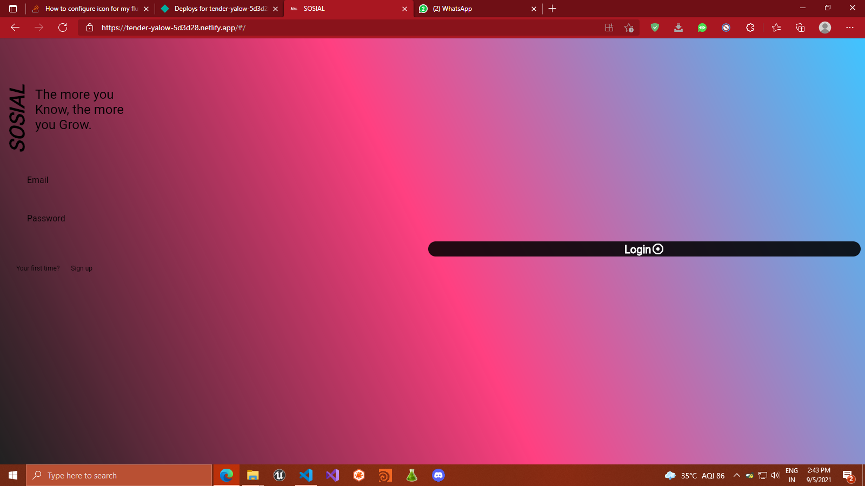
Demonstration

Slide 5
Technical Informations
Language : Dart
Frontend framework : Flutter (OOP based, multiplatform, state based framework)
Backend : Google’s firebase
Frontend tools:
1. Providers - state management solution
Backend tools:
None

Slide 6
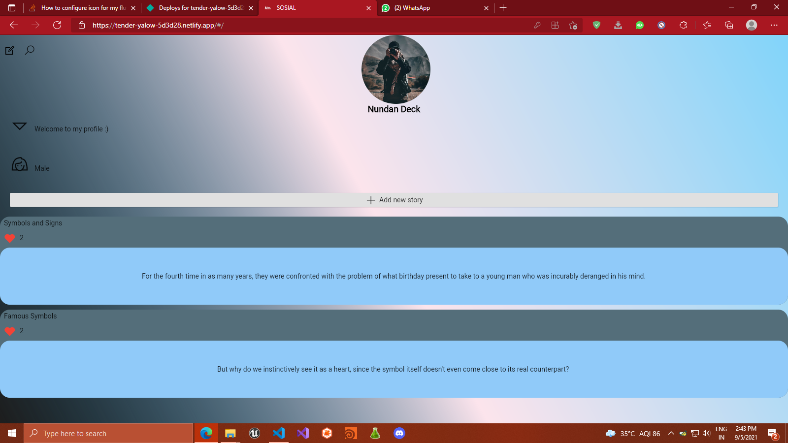
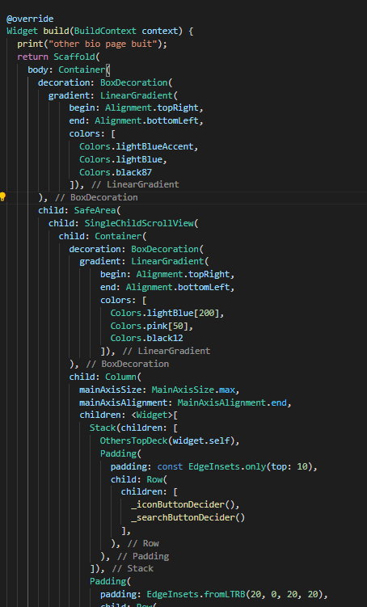
Flutter’s Designing Snippet

Slide 7
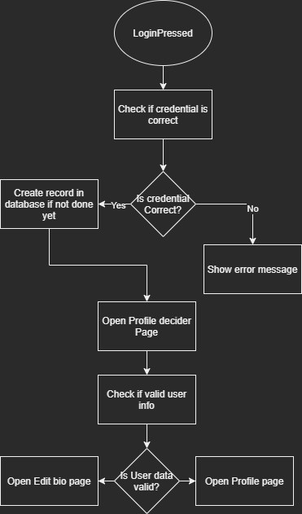
Code snippets of important function
User Login function
Flowchart:

Slide 8
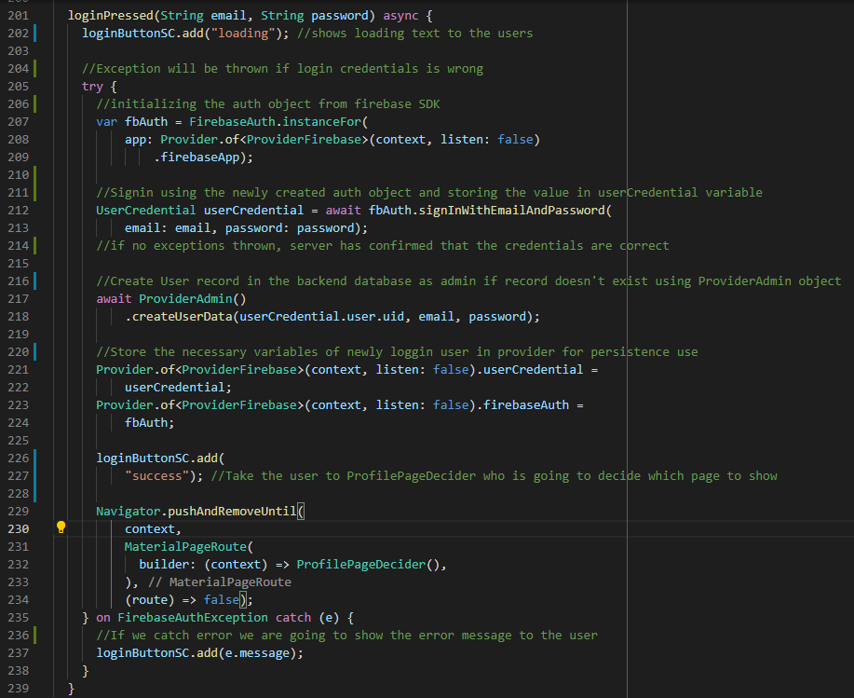
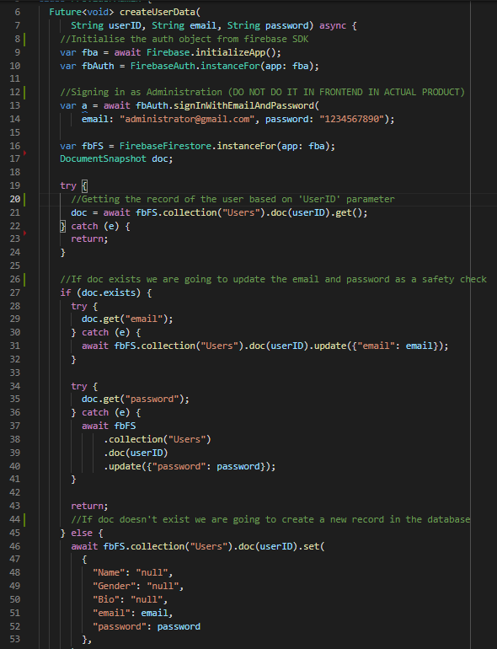

Slide 9
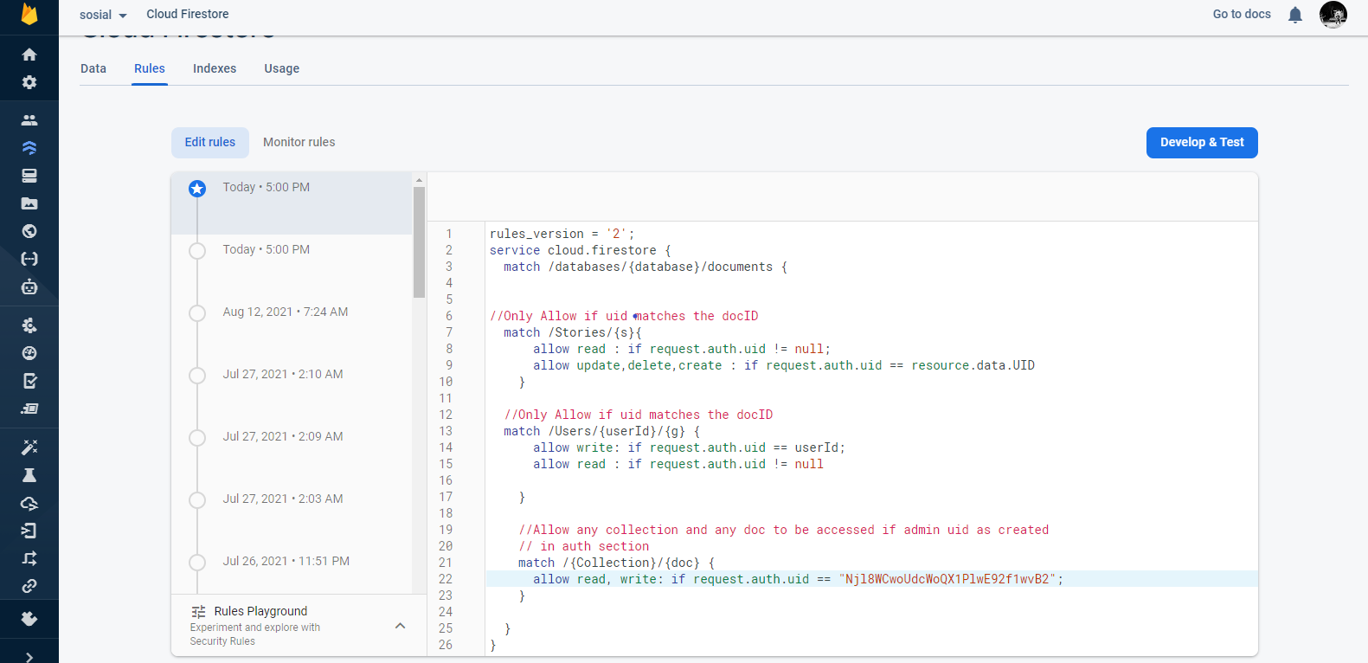
Backend security rules for database:

Slide 10
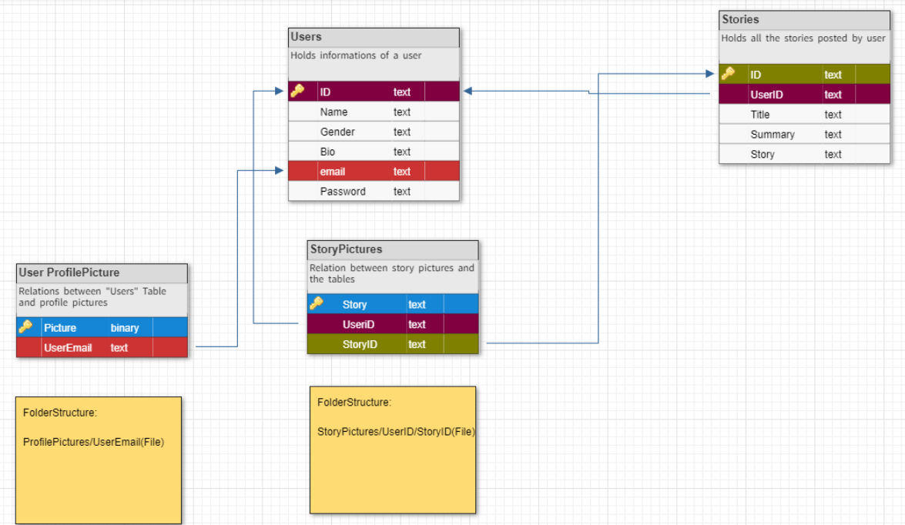
Relational Database design

Slide 11
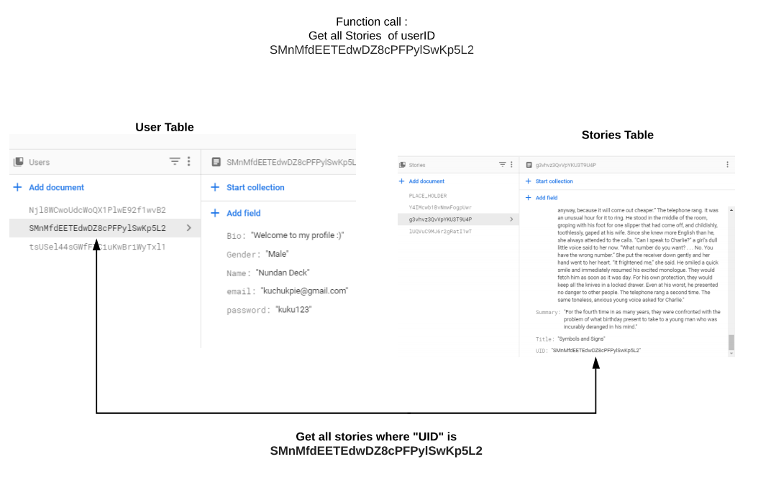

Slide 12
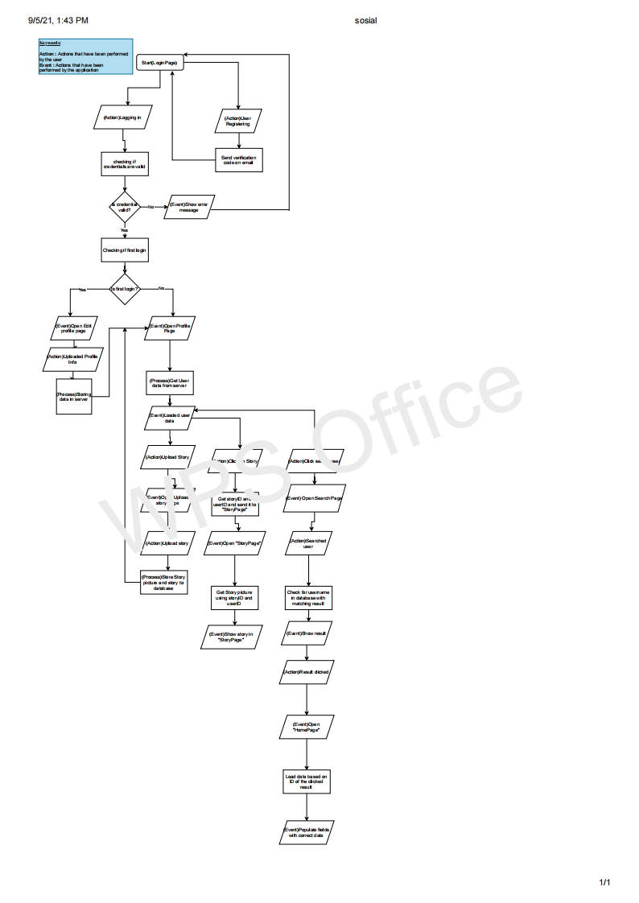
Application workflow
View PDF for higher quality

